Slide 1
DISCRETE EVENT SIMULATION
BY:
ADITYA SHAH
DEEPAL RATHOD
KRUNAL KOTHARI
MAYURI MORE
ROHAN DESAI
TANVI ZUNJARRAO
VIDHI CHITALIA
VIDHI SHAH

Slide 2
SIMULATION
A simulation is re-creation of a real-world process in a controlled environment.
It involves creating laws and models to represent the world, and then running those models to see what happens.

Slide 3
Why Simulation?
Simulation is normally used to assess the current, or predict the future, performance of a business process.
This concept is designed to help practitioners and business owners discover new ways to improve their business processes through the use of mathematical, statistical and other analytical methods.
To evaluate strategies for operation of the system

Slide 4
When Simulation is appropriate?
Simulation can be used to verify analytic solutions.
Simulations models designed for training, allow learning without the cost and disruption of on-the-job learning.
Animation shows a system in simulated operation so, that the plan can be visualized.
The modern system (factory, water fabrication plant, service organization, etc.) is so complex that the interactions can be treated only through simulation.

Slide 5
ADVANTAGES OF SIMULATION
Choose Correctly: Simulation lets you test every aspect of a proposed change or addition without committing resources to their acquisition. This is critical, because once the hard decisions have been made, the bricks have been laid, or the material-handling systems have been installed, changes and corrections can be extremely expensive. Simulation allows you to test your designs without committing resources to acquisition.

Slide 6
ADVANTAGES OF SIMULATION
Time Compression and Expansion: By compressing or expanding time simulation allows you to speed up or slow down phenomena so that you can thoroughly investigate them. You can examine an entire shift in a matter of minutes if you desire, or you can spend two hours examining all the events that occurred during one minute of simulated activity.

Slide 7
ADVANTAGES OF SIMULATION
Understand "Why?" : Managers often want to know why certain phenomena occur in a real system. With simulation, you determine the answer to the "why" questions by reconstructing the scene and taking a microscopic examination of the system to determine why the phenomenon occurs. You cannot accomplish this with a real system because you cannot see or control it in its entirety

Slide 8
ADVANTAGES OF SIMULATION
Explore Possibilities. One of the greatest advantages of using simulation software is that once you have developed a valid simulation model, you can explore new policies, operating procedures, or methods without the expense and disruption of experimenting with the real system. Modifications are incorporated in the model, and you observe the effects of those changes on the computer rather than the real system.

Slide 9
ADVANTAGES OF SIMULATION
Build Consensus. Using simulation to present design changes creates an objective opinion. You avoid having inferences made when you approve or disapprove of designs because you simply select the designs and modifications that provided the most desirable results, whether it be increasing production or reducing the waiting time for service

Slide 10
When Simulation is not appropriate?
When the problem can be solved by common sense.
When the problem can be solved analytically.
If it easier to perform direct experiments.
If cost exceeds savings.
If resources or time are not available.
If system behaviour is too complex.
If no data is available about the system, not even estimates.

Slide 11
DISADVANTAGES OF SIMULATION
Model Building Requires Special Training. It is an art that is learned over time and through experience. Furthermore, if two models of the same system are constructed by two competent individuals, they may have similarities, but it is highly unlikely that they will be the same

Slide 12
DISADVANTAGES OF SIMULATION
Simulation Results May Be Difficult to Interpret. Since most simulation outputs are essentially random variables (they are usually based on random inputs), it may be hard to determine whether an observation is a result of system interrelationships or randomness.

Slide 13
DISADVANTAGES OF SIMULATION
Simulation Modelling and Analysis Can Be Time Consuming and Expensive. Skimping on resources for modelling and analysis may result in a simulation model and/or analysis that is not sufficient for the task

Slide 14
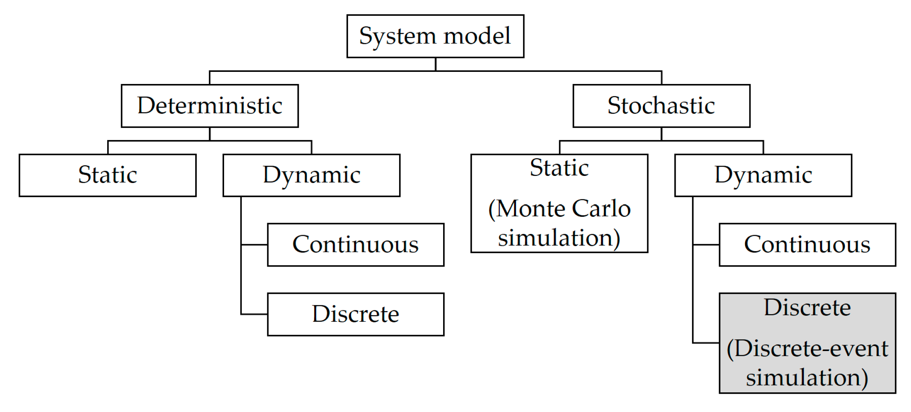
Model
Taxonomy

Slide 15
In deterministic models, the output of the model is fully determined by the parameter values and the initial conditions.
Stochastic models possess some inherent randomness. The same set of parameter values and initial conditions will lead to an ensemble of different outputs.
Static Model represents a system at particular point of time. (also known as Monte-Carlo Simulation).
Dynamic model represents systems as they change over time.
Model Taxonomy

Slide 16
WHAT IS DISCRETE EVENT SIMULATION?
Discrete-Event Simulation is the one which models the operation of a system as a discrete sequence of events in time.
Each event occurs at a instant in time and marks a change of state in the system.
Between consecutive events, no change is assumed to occur; thus, the simulation can directly jump in time from one event to the next.

Slide 17
Components
System state - The collection of state variables necessary to describe the system at a particular time
Simulation clock - A variable giving the current value of simulated time
Event list - A list containing the next time when each type of event will occur
Statistical counters - Variables used for storing statistical information about system information
Initialization routine - A subprogram to initialize the simulation model at time 0
Timing routine - A subprogram that determines the next event from the event list and then advances the simulation clock to the time when that event is to occur

Slide 18
Applications
Diagnosing process issues
Hospital applications
Lab test performance improvement ideas
Evaluating capital investment decisions
Network simulators

Slide 19
QUEUEING MODEL
Queuing system:
A basic queuing system consists of an arrival process (how customers arrive at the queue, how many customers are present in total), the queue itself, the service process for attending to those customers, and departures from the system.

Slide 20
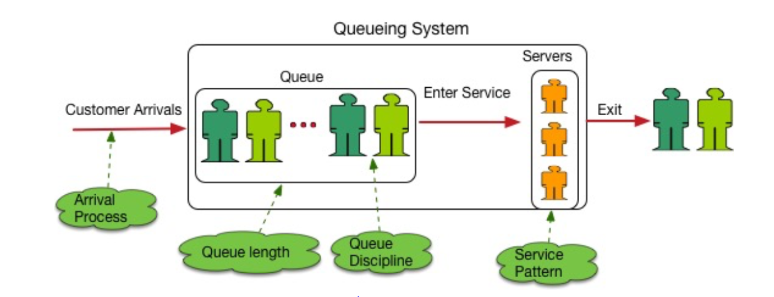
Components of a Queuing System

Slide 21
Components of a Queuing System
Arrival Process: Represents the Customer arrival pattern. We will look more into the details.
Service Pattern: how many servers we have and the speed of the Service which is called Service Rate.
Queue Length: How many people a Queuing system can hold. 10, 20, 200, infinite?
Queue Discipline: This represents if the queue will be served in First come First serve (FCFS), Last come First Serve (LCFS), Random etc. manner. Typically, it’s FCFS and that is what we will assume for the rest of the article.

Slide 22
Queue Discipline
First In First Out, or First Come First Served, is fairly common in banking and commerce. It is the type of queue you get when you have people politely lined up, waiting for their turn.
Last In First Out is the opposite scheme; whoever has been waiting for the shortest time is served first. This type of queue management is common in asset management, where assets produced or acquired last are the ones used or disposed of first. For example: the most recent employees are often the ones laid off first.
Priority is where customers are served based on their priority level; these levels could be based on status, task urgency, or some other criteria.
Shortest Job First is when whoever needs the shortest amount of service gets taken care of first
Processor Sharing is when everyone gets served, or half-served, at the same time; service capacity is distributed evenly among everyone waiting.

Slide 23
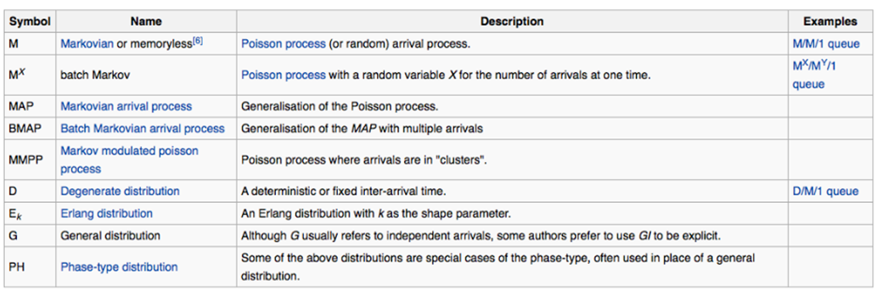
Mathematics of Queuing Theory - Kendall’s notation

Slide 24
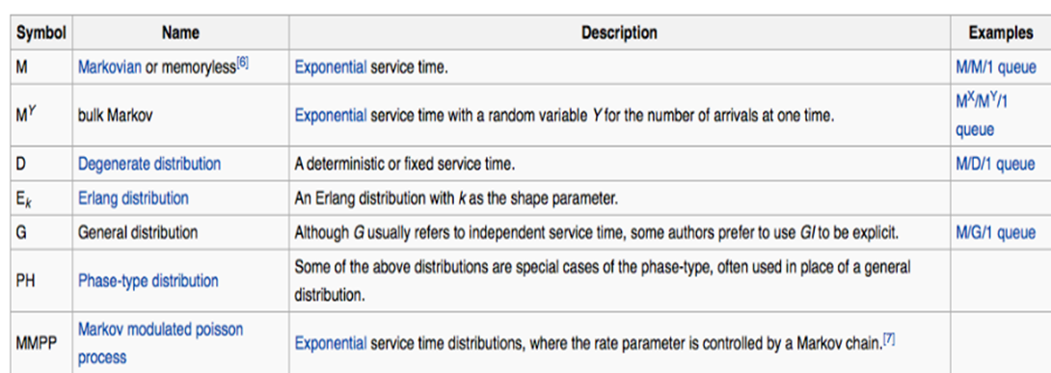

Slide 25
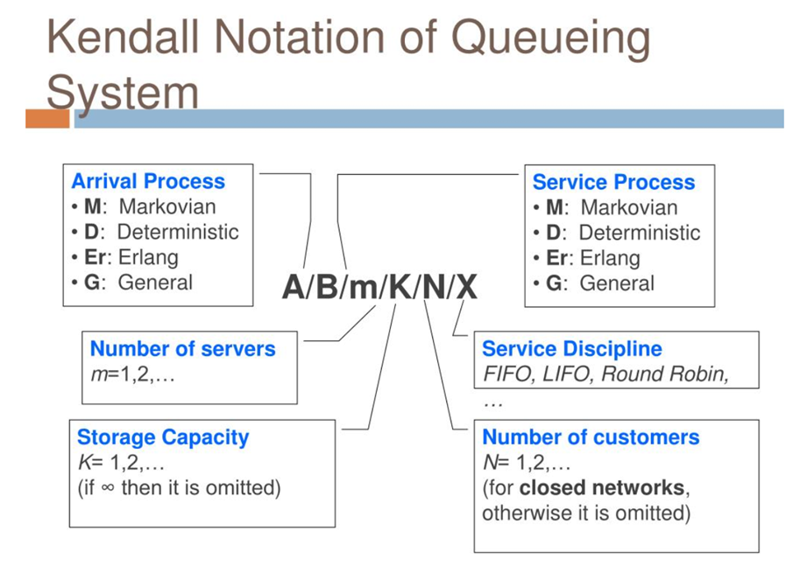

Slide 26
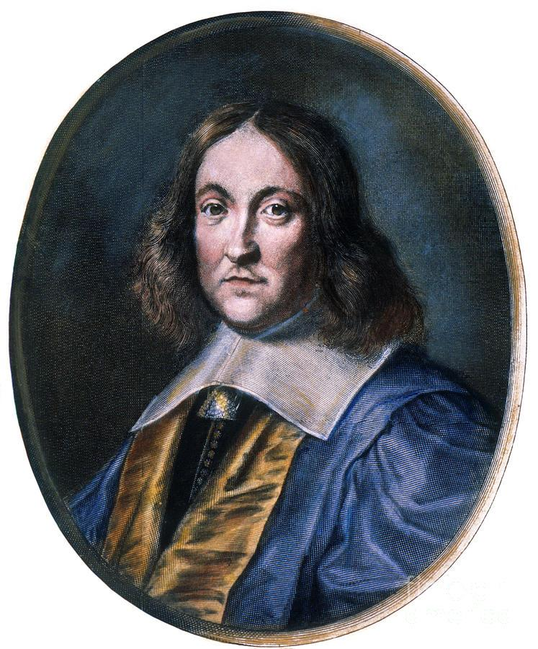
Fermat's Little Theorem
Fermat's Little Theorem is highly useful in number theory for simplifying the computation of exponents in modular arithmetic. This theorem is credited to Pierre de Fermat.

Slide 27
Consider a queue that has a process with mean arrival rate of λ entering the system. Let N be the mean number of jobs (customers) in the system (waiting and in service) and W be the mean time spent by a job in the system (waiting and in service).
Little’s Result then states that these quantities will be related to each other as: N= λW
This theorem comes in very handy to derive the waiting time given the queue length of the system.
Little Theorem

Slide 28
TYPES OF QUEUING MODEL
M/M/1/∞/∞
M/M/1/∞/∞ Queue with Discouraged Arrivals
M/M/c/∞/∞

Slide 29
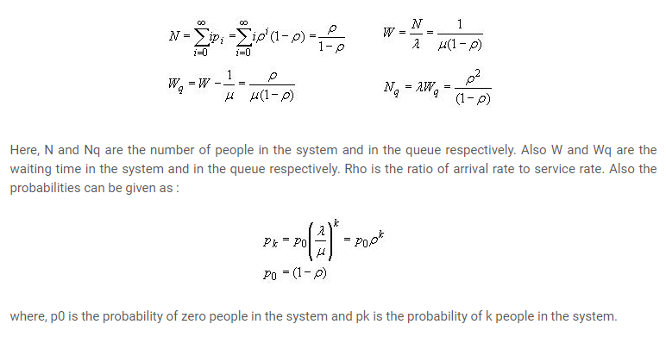
1. M/M/1/∞/∞

Slide 30
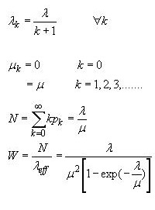
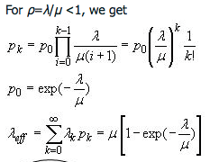
2. M/M/1/∞/∞ Queue with Discouraged Arrivals
This is one of the common distribution because the arrival rate goes down if the queue length increases.
Imagine you went to Pizza hut for a pizza party in a food court. But the queue is too long.
You would probably eat something else just because you expect high waiting time.
As you can see the arrival rate decreases with increasing k.

Slide 31
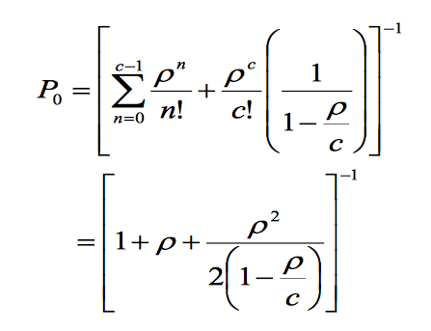
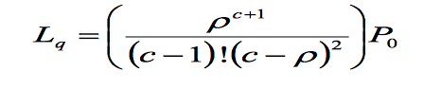
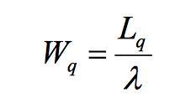
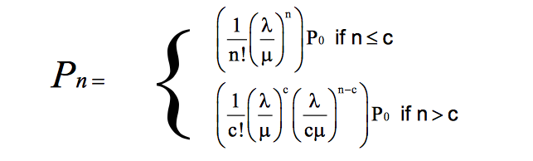
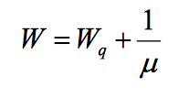
3. M/M/c/∞/∞
With c servers the equations become a lot more complex. Here are the expressions for such Markov distribution in arrival and service.

Slide 32
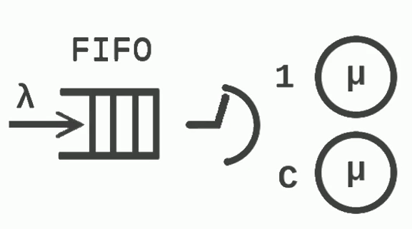
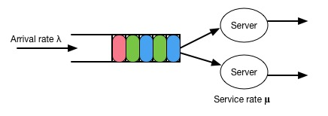
ALGORITHM- M/M/C QUEUE SYSTEM
The M/M/C queue is a classical example of the multiple servers system with a common queue.
M/M/C queue system according to Kendall’s Notation:

Slide 33
M/M/C MODEL PARAMETERS
Capacity is total number of entities for simulation.
Number Of Servers is the number of servers.
Inter Arrival Time is mean value between entities arrivals.
Service Time is mean value of service time.
Exp Time is a block function returning exponentially distributed random values.
Random Selection is the block parameter for selection rule.

Slide 34
Let's consider an example for a call center

Slide 35
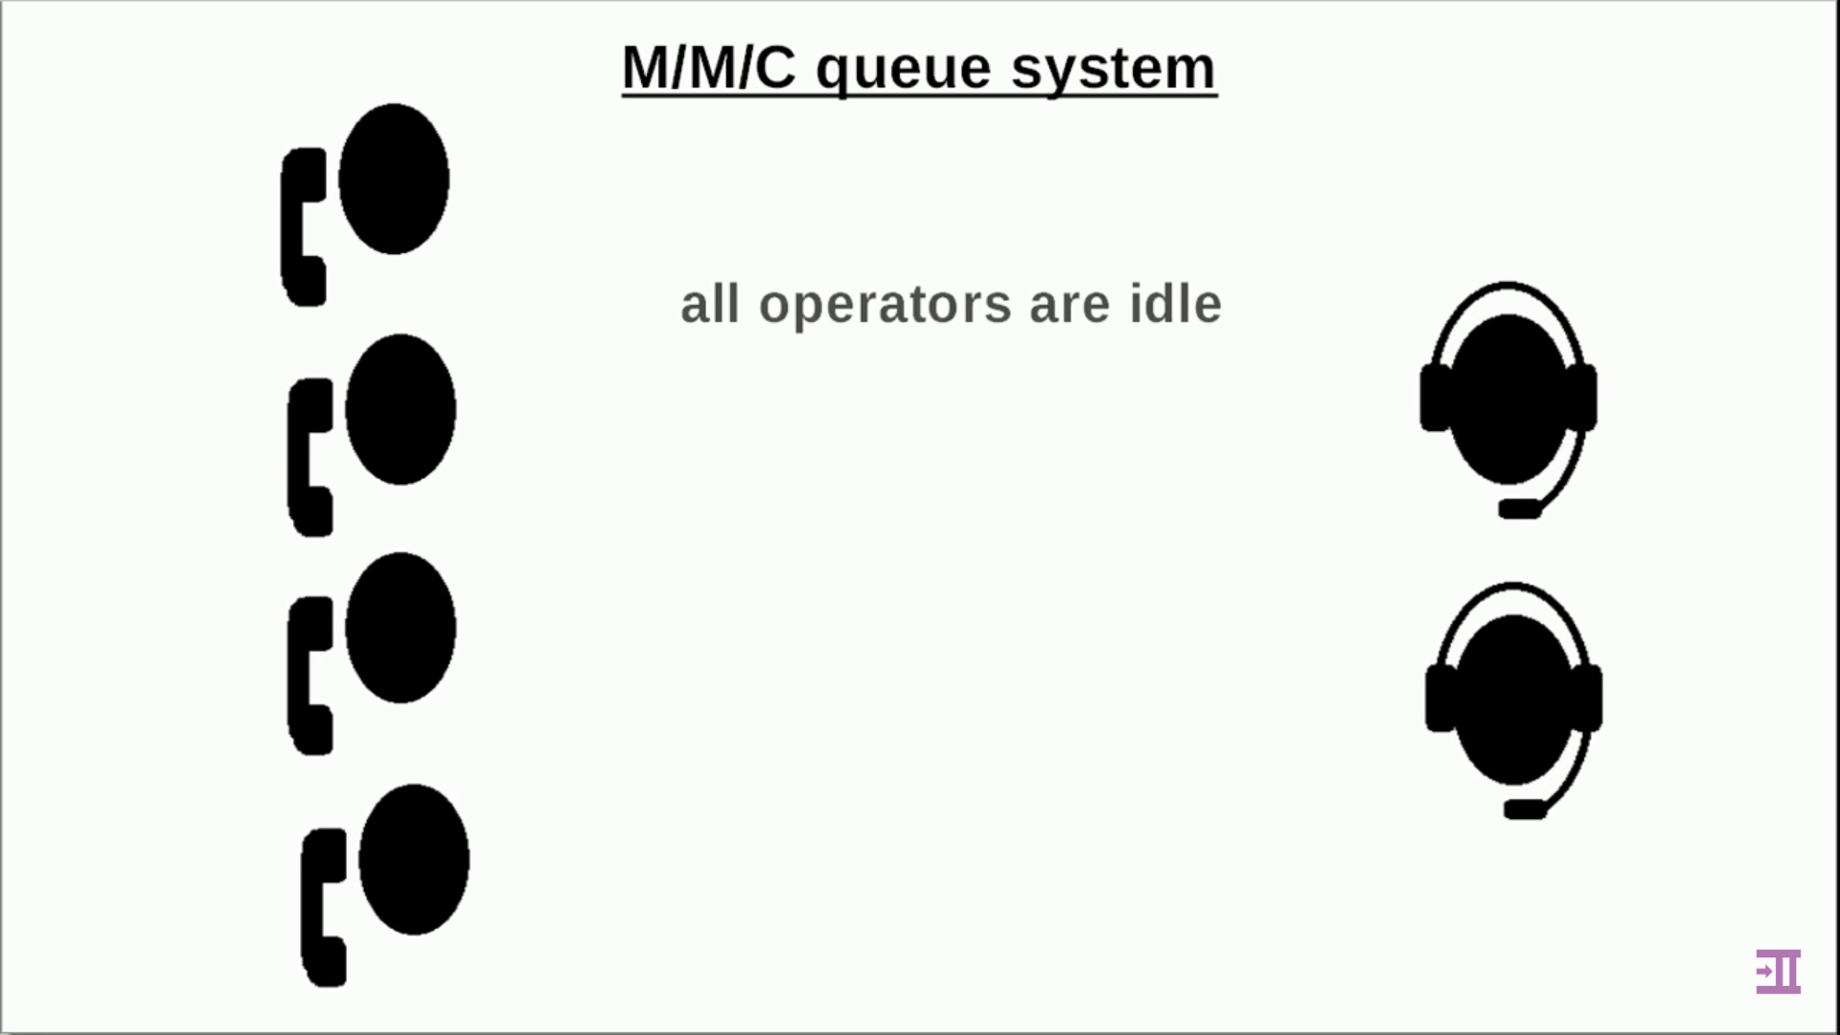

Slide 36


Slide 37
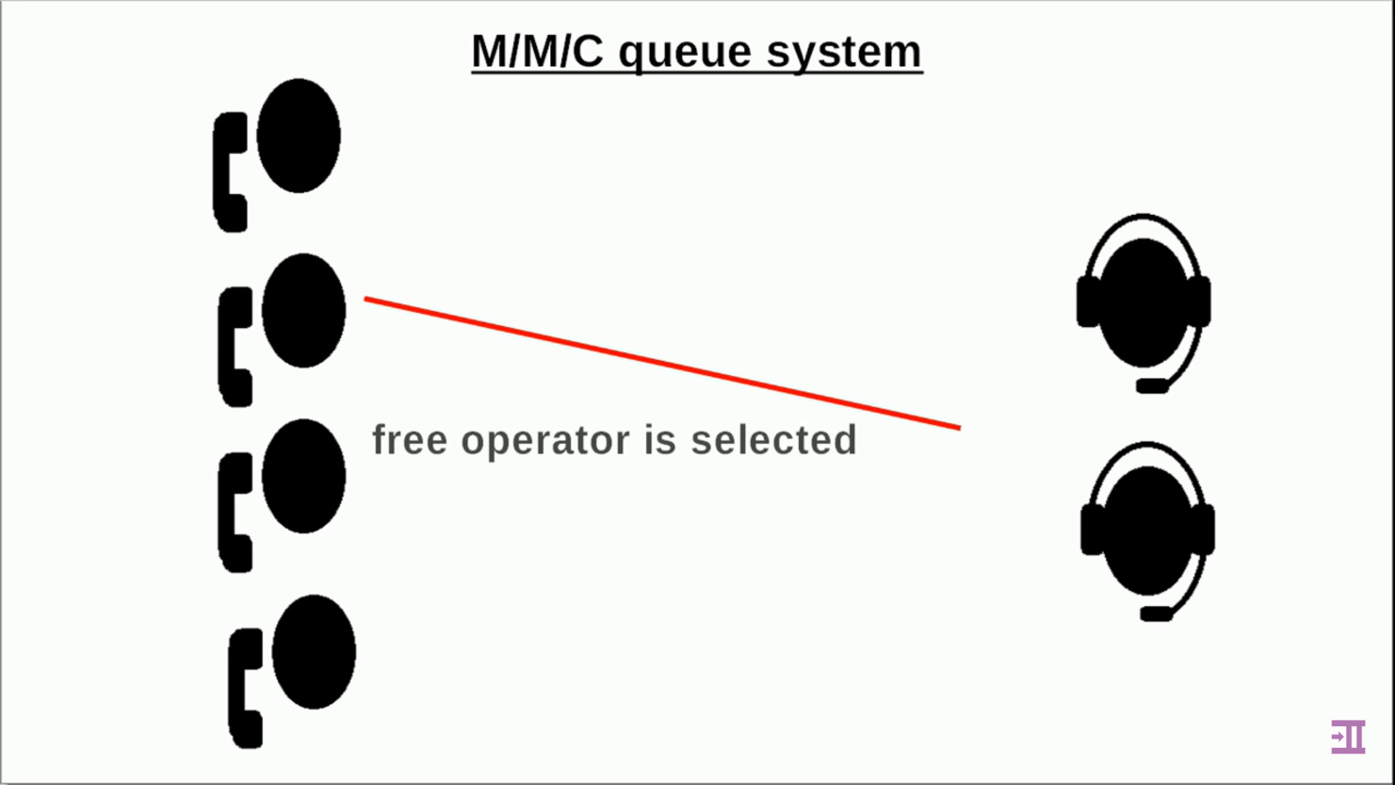

Slide 38
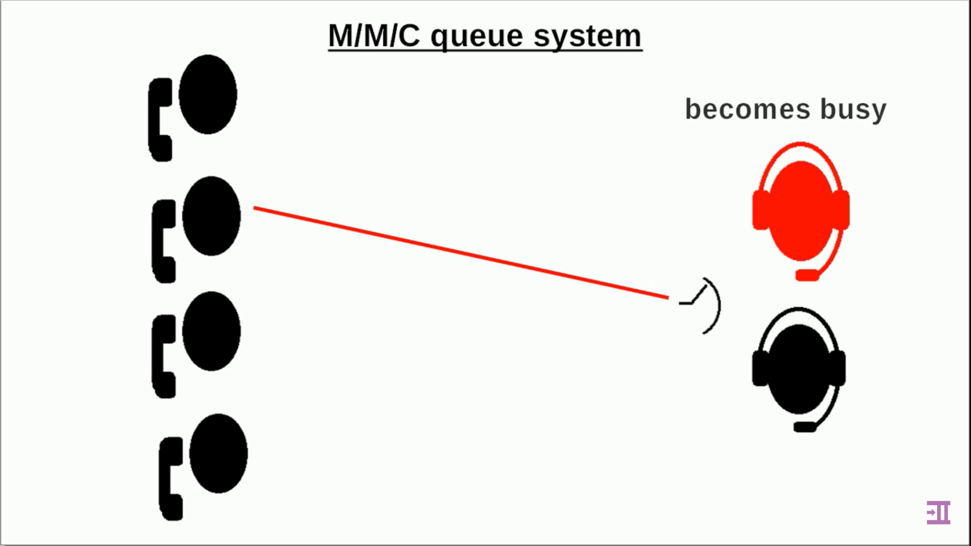

Slide 39
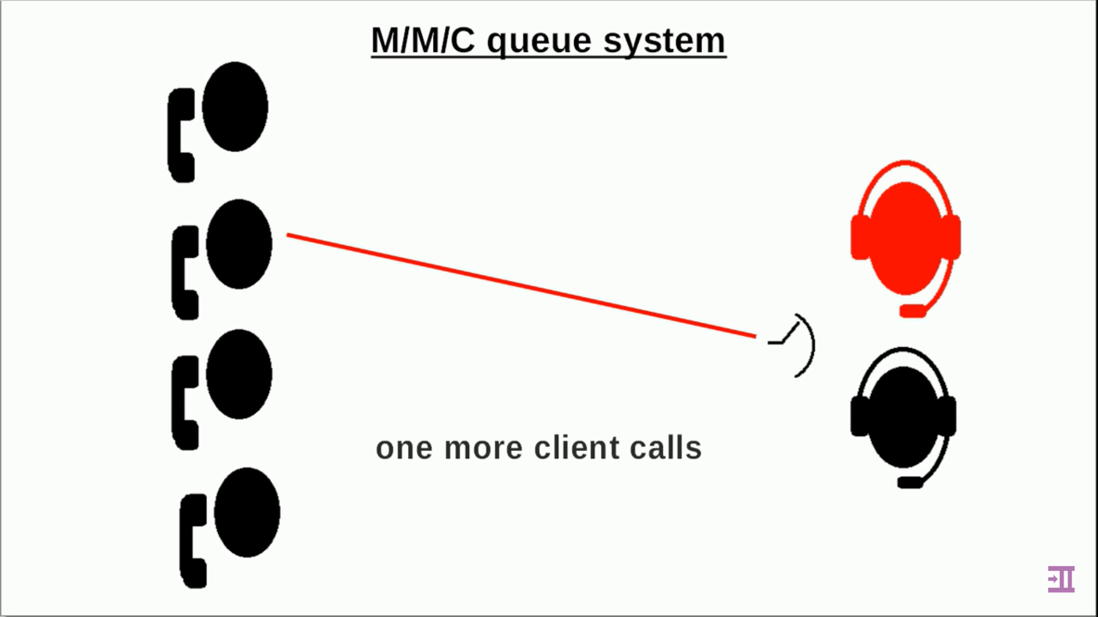

Slide 40
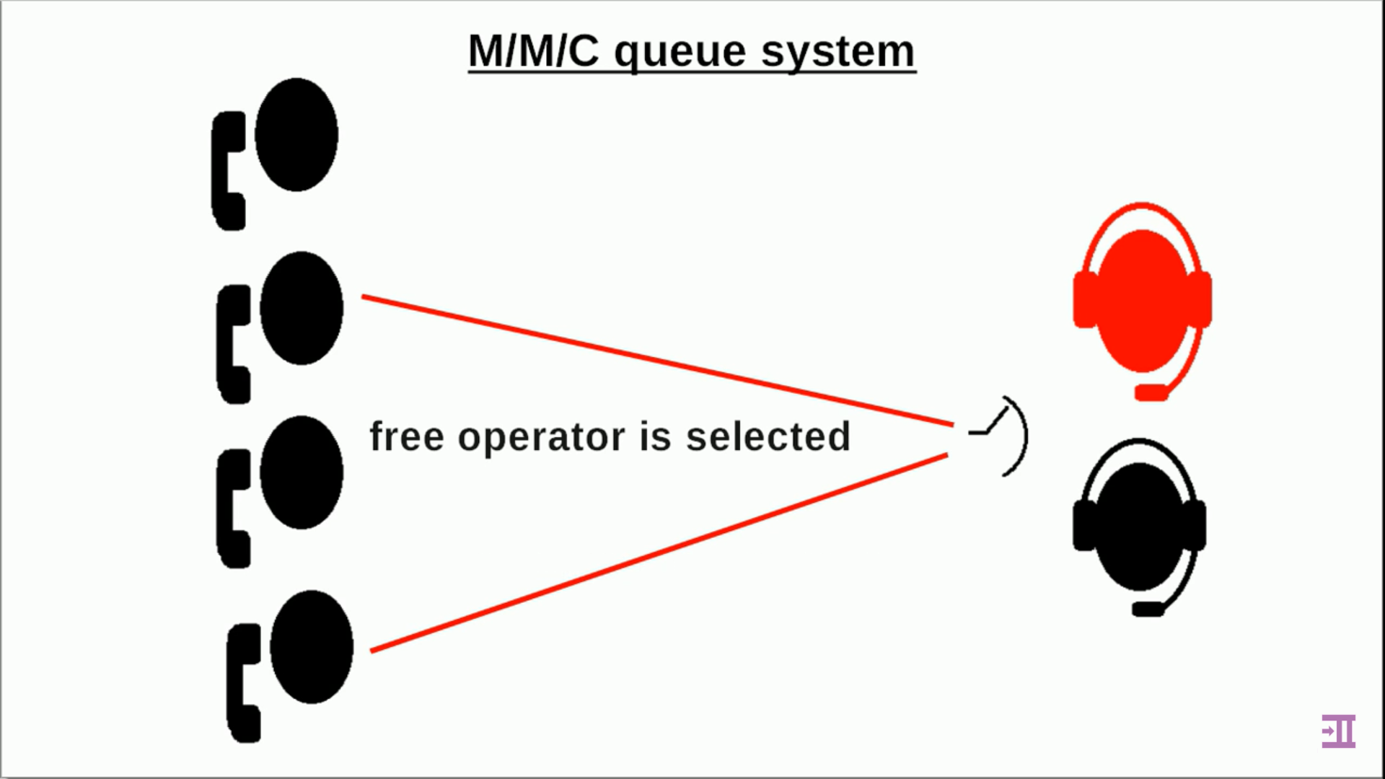

Slide 41
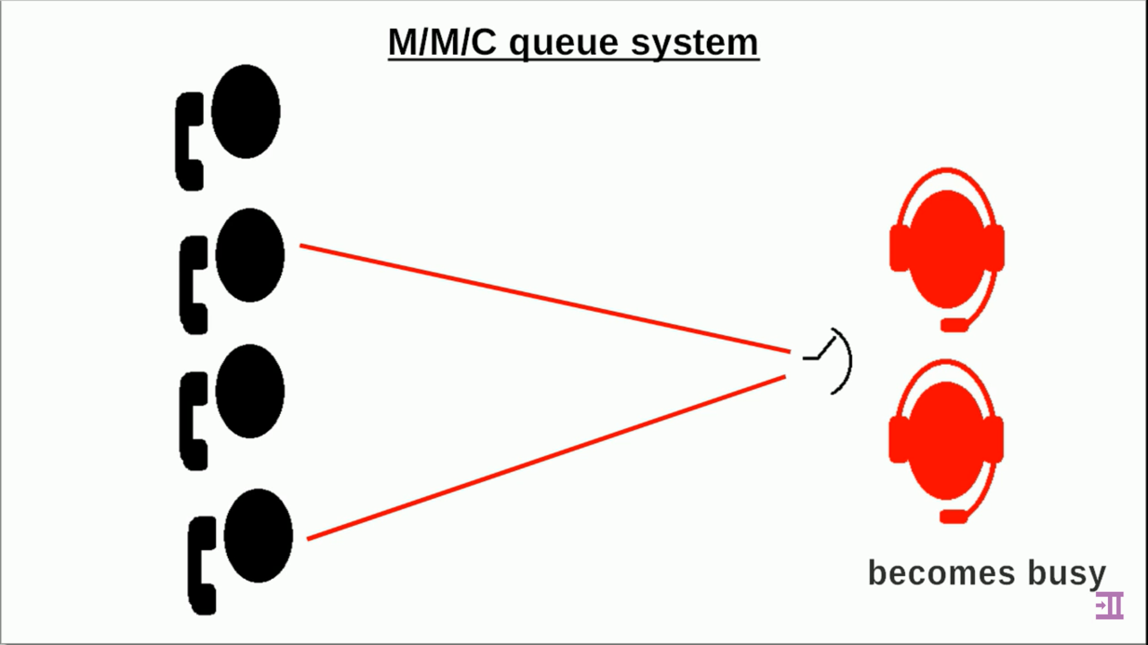

Slide 42
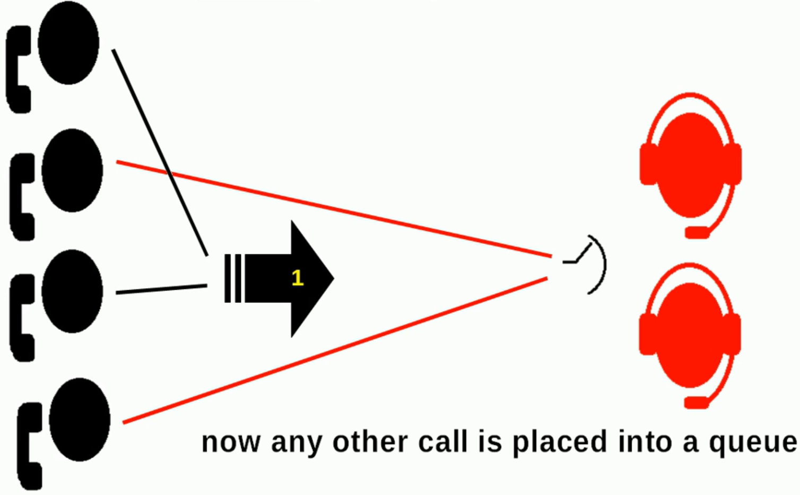

Slide 43
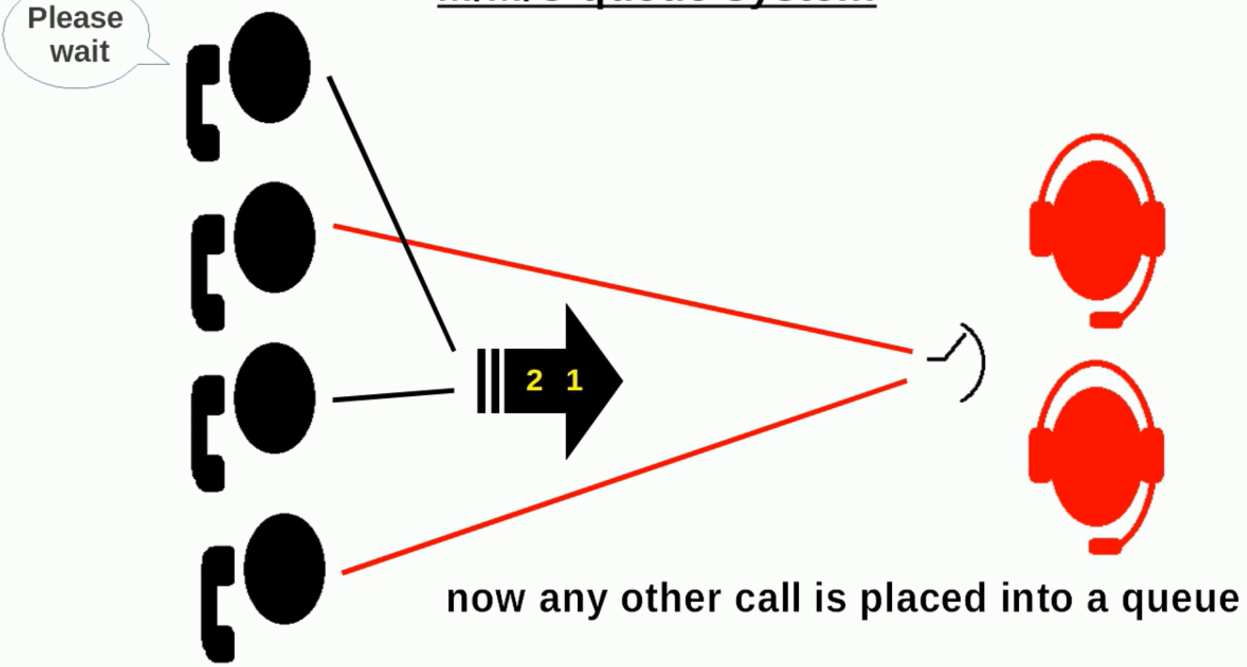

Slide 44
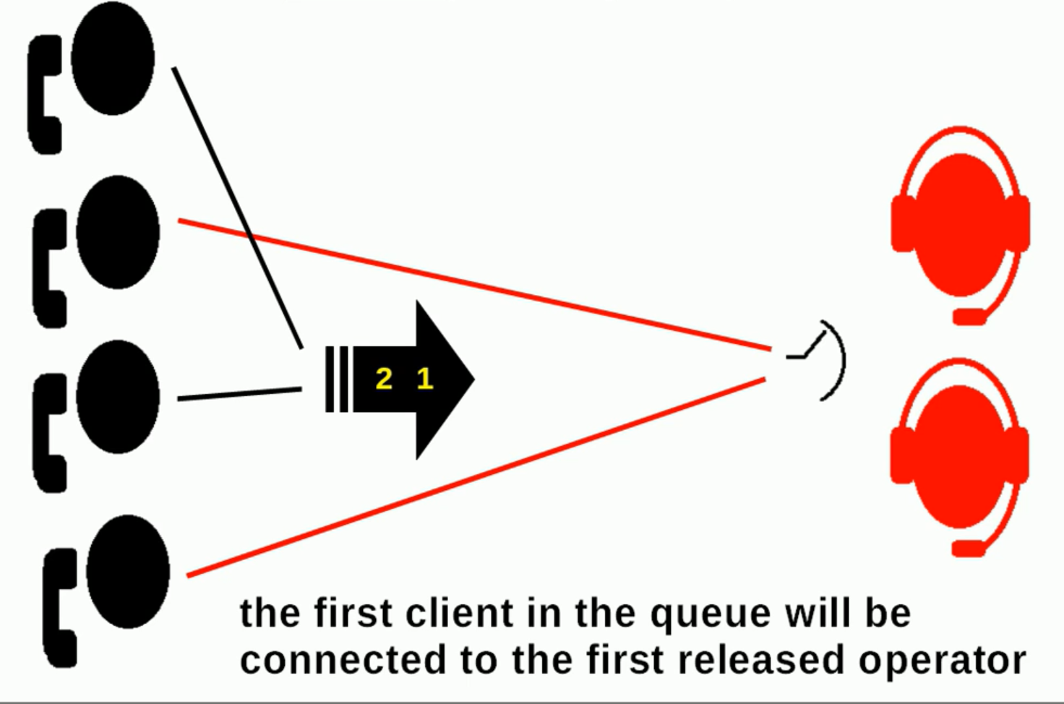

Slide 45
THANK YOU!

